Slide 1
Lecture 9 Streams and Events
Kyu Ho Park
April 13, 2017
Ref:[PCCP]Professional CUDA C Programming

Slide 2
CUDA Stream
stream: a sequence of asynchronous CUDA operations that execute on a device in the order issued by the host code
A stream encapsulates these operations, maintains their ordering, permits operations to be queued in the stream to be executed after all preceding operations, and allows for querying the status of queued operations. These operations can include host-device data transfer, kernel launches, and most other commands that are issued by the host but handled by the device
While operations within the same CUDA stream have a strict ordering, operations in different streams have no restriction on execution order. By using multiple streams to launch multiple simultaneous kernels, you can implement grid level concurrency

Slide 3
CUDA Execution Flow
CUDA Program Execution Flow:
Step1.Host sends Input data to the Device,
Step2.The data is processed by Kernel functions,
Step3.The result is sent to the Host.
Observation:
*During step1, GPU just waits for the completion of the data transfer.
*If the input data is sliced to small blocks and send them one by one to the device, then the device can process the arrived blocks concurrently.

Slide 4
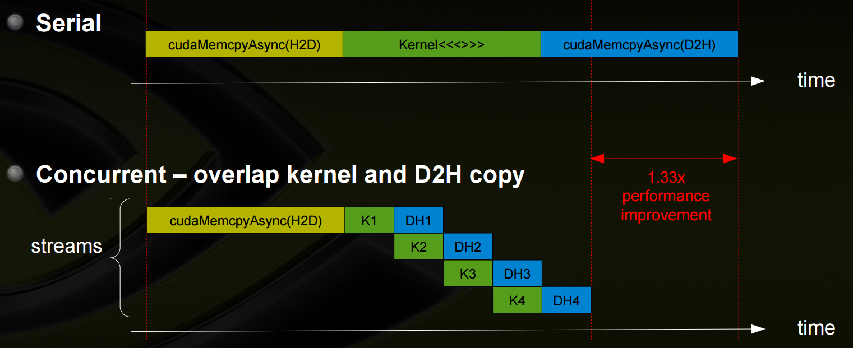
Concurrency
[Justin Luitjens,NVIDIA]

Slide 5
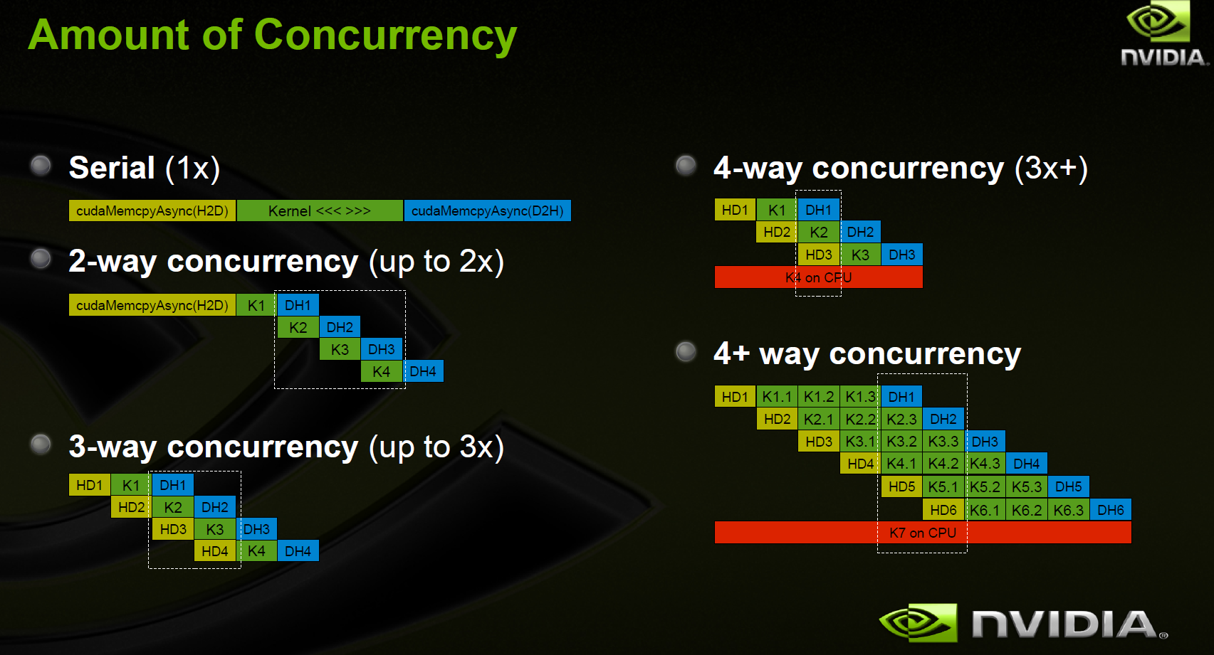
Amount of Concurrency
[Justin Luitjens,NVIDIA]

Slide 6
Concurrency in CUDA C
Kernel level concurrency:
A kernel executed in parallel by many threads.
Grid level concurrency:
Multiple kernels are executed simultaneously on a single device.

Slide 7
Synchronous, Asynchronous
Functions in the CUDA API:
Synchronous behavior: They block the host thread until
they complete.
Asynchronous behavior: Enqueue work and return
immediately.

Slide 8
CUDA Streams
All CUDA operations(including kernels and data transfers) either explicitly or implicitly run in a stream.
Two types of streams:
-Implicitly declared stream(NULL stream):
It is the default stream if you do not explicitly specify a stream.
-Explicitly declared stream(non-NULL stream):
If you want to overlap different CUDA operations we use non_NULL streams. -> kernel function에서 <<<G,B,shared size, flag(이 flag가 asynchronus하게 설정가능) >>>

Slide 9
Coarse-grain concurrency
Overlapped host computation and device computation
Overlapped host computation and host-device data transfer
Overlapped host-device data transfer and device computation
Concurrent device computation

Slide 10
CUDA Program behavior
cudaMemcpy(…., cudaMemcpyHostToDevice);
kernelFunction<<<grid, block>>>(argument list);
cudaMemcpy(…, cudaMemcpyDeviceToHost);
From the host perspective, each data transfer is synchronous and forces idle host time while waiting for them to complete.
The kernel launch is asynchronous, and the host application immediately resumes execution regardless of whether the kernel completed or not.
The default asynchronous behavior for kernel launches make it to overlap device and host computation.

Slide 11
Asynchronous Data Transfer
Asynchronous version of cudaMemcpy:
cudaError_t cudaMemcpyAsync(void *dst, const void* src, size_t count, cudaMemcpyKind kind, cudaStream_t stream=0);
To create a non-null stream:
cudaError_t cudaStreamCreate(cudaStream_t* pStream);
When performing an asynchronous data transfer, you must use pinned(non-pageable) host memory. Pinned memory can be allocated using cudaMallocHost or cudaHostAlloc:
cudaError_t cudaMallocHost(void **ptr, size_t size);
cudaError_t cudaHostAlloc(void **pHost, size_t size, unsigned int flag);

Slide 12
Why pinned memory?
Forcing the physical location in CPU memory to remain constant throughout the data transfer.
Otherwise the OS is free to change the physical location of host
virtual memory at anytime.

Slide 13
Kernel with non-default stream
kernelFunction<<<grid, block,sharedMemSize, stream>>>(argument list);
Non-default stream declaration , creation and destroy:
cudaStream_t stream;
cudaStreamCreate(&stream);
cudaError_t cudaStreamDestroy(cudaStream_t stream);

Slide 14
APIs To check all stream operations
cudaError_t cudaStreamSynchronize(cudaStream_t stream);
forces the host to block until all operations in the provided stream have completed
cudaError_t cudaStreamQuery(cudaStream_t stream);
checks if all operations in a stream have completed, but does not block the host if they have not completed
returns cudaSuccess if all operations are complete or cudaErrorNotReady if one or more operation is still executing or pending execution

Slide 15
Example1
cudaStreamCreate(&stream1);
cudaStreamCreate(&stream2);
cudaMemcpyAsync(d_In1,h_In1,dataSize1,
cudaMemcpyHostToDevice, stream1);
cudaMemcpyAsync(d_In2,h_In2,dataSize2,
cudaMemcpyHostToDevice, stream2);
kernel1<<<grid, block,0,stream1>>>(d_In1,d_Out1);
kernel2<<<grid,block,0,stream2>>>(d_In2,d_Out2);
cudaStreamDestroy(stream1);
cudaStreamDestroy(stream2);
…

Slide 16
Example 2
for(int i=0;i<nStreams; i++){
int offset=i*bytesPerStream;
cudaMemcpyAsync(&d_a[offset],&a[offset],bytePerStream ,streams[i]);
kernel<<<grid,block,0,streams[i]>>>(&d_a[offset]);
cudaMemcpyAsync(&a[offset],&d_a[offset],bytesPerStream, streams[i]);
}
for (int i = 0; i < nStreams; i++) { cudaStreamSynchronize(streams[i]); }

Slide 17
Streams Execution Flow
stream0
HtoD
K1
DtoH
stream1
HtoD
K2
DtoH
stream2
HtoD
K3
DtoH
HtoDs can not be overlapped, but DtoH and HtoD are overlapped, Why?
cpu ----------- device
pcie (HtoDs overlapped x, DtoH, HtoD overlapped 된다 (duplex PCIe 이면). physical 적인 성질 때문에)

Slide 18
Stream Priority
cudaError_t cudaStreamCreateWithPriority(cudaStream_t* pStream, unsigned int flags, int priority);
*Grids queued to a higher priority stream may preempt work already executing an a low priority stream.
*Stream priorities have no effect on data transfer operations, only on compute kernels.
*The allowable range of priorities for a given device can be queried by the following function:
cudaError_t cudaDeviceGetStreamPriorityRange(int *leastPriority,
int *greatestPriority);

Slide 19
CUDA Events
event : an event in CUDA is a marker in a CUDA stream. The event can be used to synchronize stream execution and monitor device progress.
CUDA API allows you to insert events at any point in a stream as well as query for event completion.
An event declaration, creation and destruction:
cudaEvent_t event;
cudaError_t cudaEventCreate(cudaEvent_t* event);
cudaError_t cudaEventDestroy(cudaEvent_t event);

Slide 20
How to use events
cudaError_t cudaEventRecord(cudaEvent_t event, cudaStream_t stream=0);
//An event is queued to a CUDA stream
cudaError_t cudaEventSynchronize(cudaEvent_t event);
//Waiting for an event
cudaError_t cudaEventQuery(cudaEvent_t event);
//Test if an event has completed
cudaError_t cudaEventElapsedTime(float* ms, cudaEvent_t start, cudaEvent_t stop);
//Measure the elapsed time of CUDA operations marked by //two events(here, start and stop)

Slide 21
example
//create two events
cudaEvent_t start, stop;
cudaEventCreate(&start);
cudaEventCreate(&stop);
//recort start event on the default stream
cudaEventRecord(start);
//execute kernel
kernel<<<grid,block>>>(arguments);
//record stop event on the default stream
cudaEventRecord(stop);
//wait until the stop event completes
cudaEventSynchronize(stop);
//calculate the elapsed time between two events
float time;
cudaEventElapsedTime(&time, start,stop);
cudaEventDestroy(start);
cudaEventDestroy(stop);

Slide 22
start and stop events
The start and stop events are placed into the NULL stream by default. A timestamp is recorded for the start event at the beginning of the NULL stream, and a timestamp for the stop
event at the end of the NULL stream.

Slide 23
Stream Synchronization
CUDA operations
Memory-related operations
Kernel launches
Streams
Asynchronous streams(non-NULL streams)
Synchronous streams(NULL/default stream)
Non-NULL streams:
Blocking streams
Non-blocking streams

Slide 24
Stream Synchronization
non-null stream
Asynchronous stream with respect to the host
All operations applied to it do not block host execution.
NULL stream
Synchronous stream with respect to the host.
Most operations added to the NULL stream cause the host to block on all preceding operations, the main exception being kernel launches.

Slide 25
Stream Synchronization
Blocking stream
- Null stream과 sync을 맞춰야한다.
Non-blocking stream
- Null stream 신경 x

Slide 26
Blocking and Non-Blocking Streams
Non-NULL streams are non-blocking with respect to the host, but operations within a non-Null stream can be blocked by operations in the NULL stream. If a non-NULL stream is a blocking stream, the NULL stream can block operations in it.
< stream_1 & stream_2 blocking streams>
kernel_1<<<1,1,0,stream_1>>>();
kernel_2<<<1,1>>>();
kernel_3<<<1,1,0,stream_2>>>();
-kernel_2 does not start executing until kernel_1 completes
and kernel_3 does not start until kernel_2 completes.

Slide 27
Blocking and Non-Blocking Streams
The NULL stream is an implicit stream, which synchronizes with all other blocking streams in the same CUDA context
when an operation is issued to the NULL stream, the CUDA context waits on all operations previously issued to all blocking streams before starting that operation
any operations issued to blocking streams will wait on preceding operations in the NULL stream to complete before executing.

Slide 28
cudaError_t cudaStreamCreateWithFlags(cudaStream_t* pStream, unsigned int flags);
flags:
cudaStreamDefault: default stream creating flag (blocking).
cudaStreamNonBlocking: asynchronous stream creation flag(non-blocking). It disables the blocking behavior of non_NULL streams relative to the NULL stream.
If stream_1 and stream_2 in the previous slide were created with cudaStreamNonBlocking, non of the kernel executions would be blocked waiting for completion of any of the other kernels.

Slide 29
Implicit Synchronization
Many memory related operations imply blocking on all previous operations on the current device:
-A page-locked host memory allocation
-A device memory allocation
-A device memset
-A memory copy between two addresses on the same device
-A modification to the L1/shared memory configuration

Slide 30
Configuring the Amount of Shared Memory [Lecture 7 Shared Memory]
Each SM has 64KBytes of on-chip memory which are shared by the Shared memory and L1 cache.
Per-device configuration:
cudaError_t cudaDeviceSetCacheConfig(cudaFuncCache cacheConfig);
Per-kernel configuration:
cudaError_t cudaFuncSetCacheConfig(const void* func, enum cudaFuncCachecacheConfig);

Slide 31
Explicit Synchronization
-synchronizing the device
-synchronizing a stream
-synchronizing an event in a stream
-synchronizing across streams using an event:
cudaError_t cudaStreamWaitEvent(cudaStream_t stream,
cudaEvent_t event);

Slide 32
Configurable Events
cudaError_t cudaEventCreateWithFlags(cudaEvent_t*event, unsigned int flags);
flags:
cudaEventDefault
cudaEventBlockingSync
cudaEventDisableTiming
cudaEventInterprocess

Slide 33
Concurrent Kernels in Non-NULL Streams
1.A set of non-null streams are created first:
cudaStream_t *streams=(cudaStream_t *)malloc(n_streams*sizeof(cudaStream_t));
for( int i=0; i<n_streams; i++){
cudaStreamCreate(&streams[i]); }
2.Kernels:
dim3 block(1);
dim3 grid(1);
for(int i=0;i<n_streams;i++){
kernel_1<<<grid,block,0,streams[i]>>>();
kernel_2<<<grid,block,0,streams[i]>>>();
kernel_3<<<grid,block,0,streams[i]>>>();
kernel_4<<<grid,block,0,streams[i]>>>();
}

Slide 34
3.Meaure the elapsed time using start and stop events:
cudaEvent_t start, stop;
cudaEventCreate(&start);
cudaEventCreate(&stop);
cudaEventRecord(start);
for(int i=0; i<n_streams; i++) {
….
}
cudaEventRecord(stop);
cudaEventSynchronize(stop);
cudaEventElapsedTime(&elapsed_time, start,stop);

Slide 35
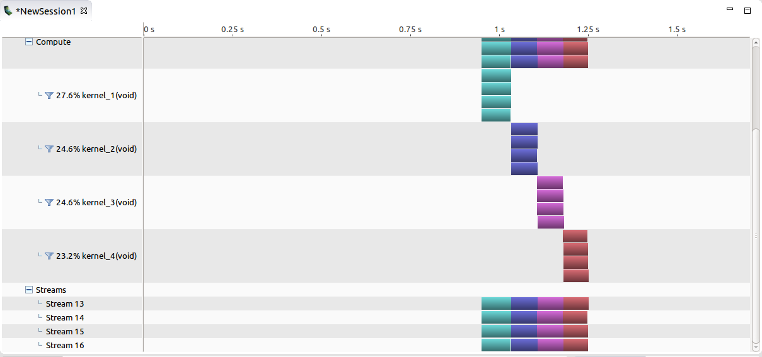
Concurrent Kernel in Non-NULL Streams

Slide 36
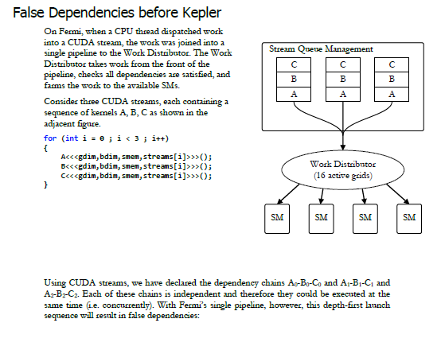
False Dependency
[Hyper-Q Example,Thomas Bradley,NVIDIA 2012]

Slide 37
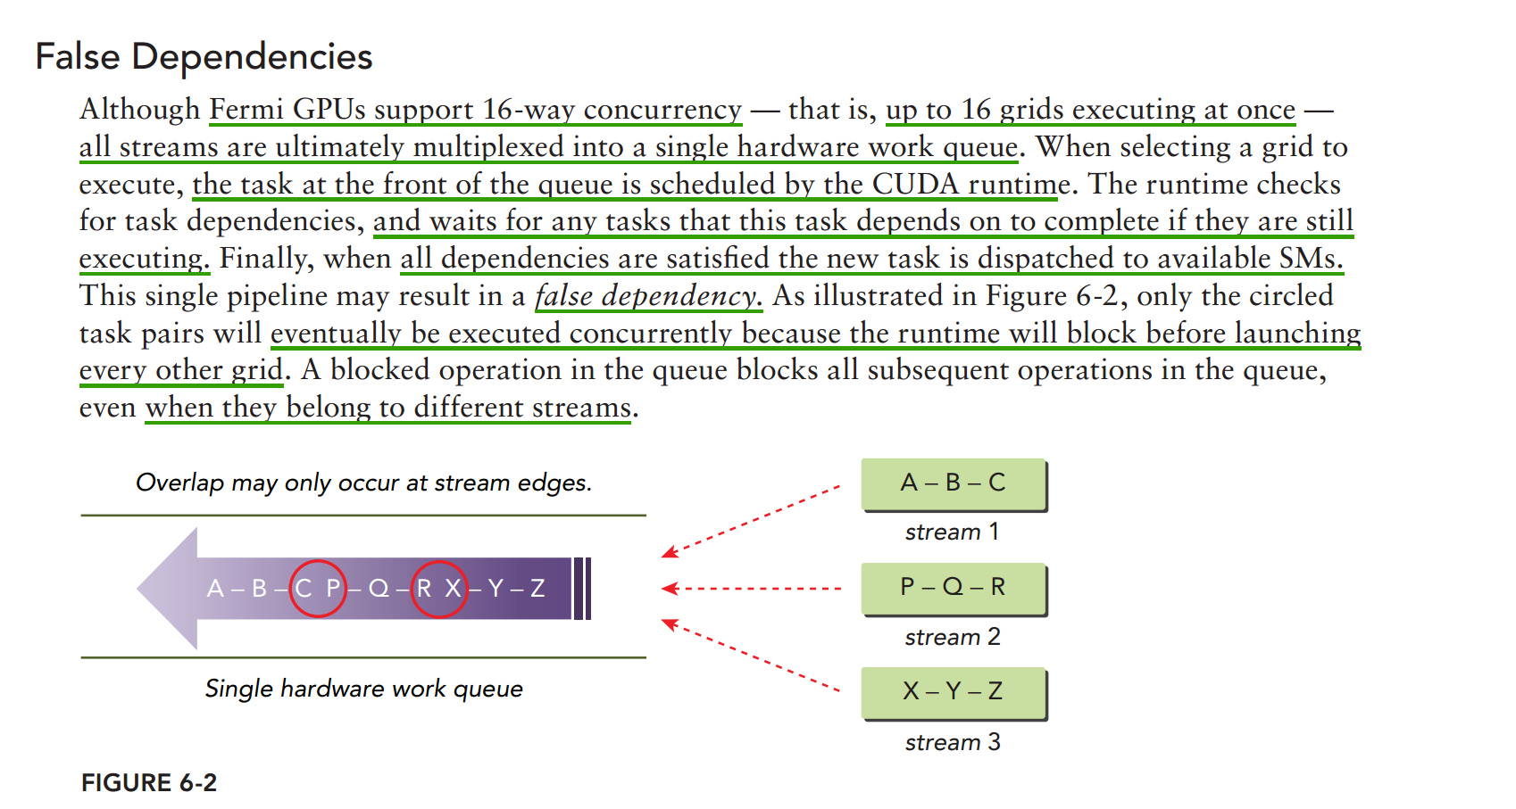

Slide 38
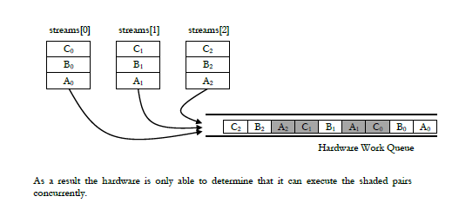
False Dependency
[Hyper-Q Example,Thomas Bradley,NVIDIA 2012]

Slide 39
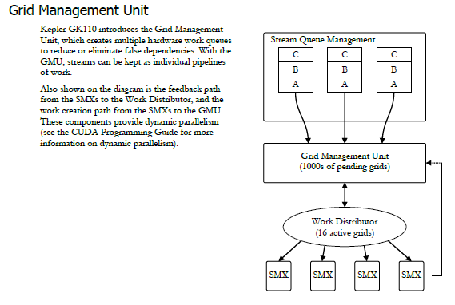
[Hyper-Q Example,Thomas Bradley,NVIDIA 2012]

Slide 40
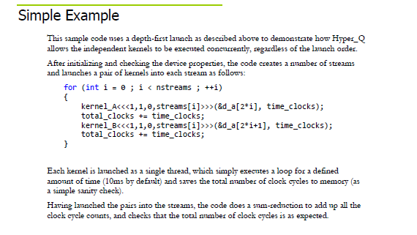

Slide 41
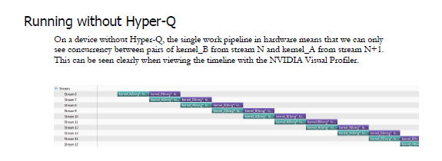

Slide 42
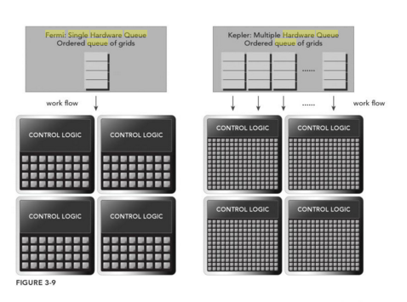
Hyper-Q
[PCCP]

Slide 43
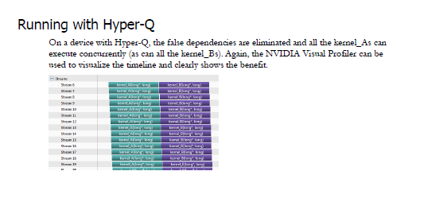

Slide 44
Adjusting Stream Behavior Using Environment Variables
In the C host program:
setenv(“CUDA_DEVICE_MAX_CONNECTIONS”,”32”,1);
#define NSTREAM 8
//set up maximum connection to 4
char* iname=“CUDA_DEVICE_MAX_CONNECTIONS”;
setenv(iname,”4”,1);
CUDA_DEVICE_MAX_CONNECTIONS : hyper-q 갯수

Slide 45
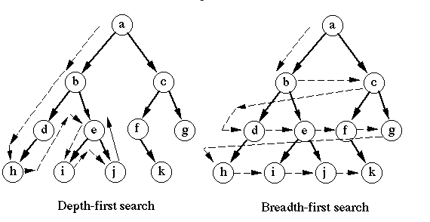
Depth-First and Breadth-First Search

Slide 46
Depth-First Approach
dim3 block(1);
dim3 grid(1);
for(int i=0;i<n_streams;i++){
kernel_1<<<grid,block,0,streams[i]>>>();
kernel_2<<<grid,block,0,streams[i]>>>();
kernel_3<<<grid,block,0,streams[i]>>>();
kernel_4<<<grid,block,0,streams[i]>>>();
}

Slide 47
#define NSTREAM 8
There are 8 streams in depth-first order,
Stream0: k1(0)-k2(0)-k3(0)-k4(0),
Stream1: k1(1)-k2(1)-k3(1)-k4(1),
Stream2: k1(2)-k2(2)-k3(2)-k4(2),
…
Stream7: k1(7)-k2(7)-k3(7)-k4(7).
But the system allows only 4-way concurrency, two-streams share each queue.

Slide 48
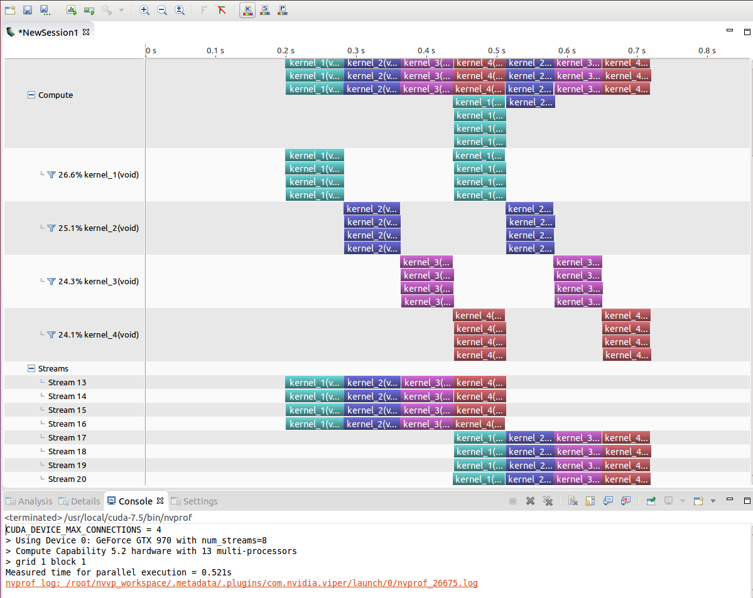
Dispatching the kernels in Depth-First Order

Slide 49
Breadth-First approach
for(int i=0;i<n_streams;i++)
kernel_1<<<grid,block,0,streams[i]>>>();
for(int i=0;i<n_streams;i++)
kernel_2<<<grid,block,0,streams[i]>>>();
for(int i=0;i<n_streams;i++)
kernel_3<<<grid,block,0,streams[i]>>>();
for(int i=0;i<n_streams;i++)
kernel_4<<<grid,block,0,streams[i]>>>();

Slide 50
k1(0)-k1(1)-k1(2)-k1(3)-k1(4)-k1(5)-k1(6)-k1(7),
k2(0)-k2(1)-…. -k2(7),
k3(0)-k3(1)-….. -k3(7),
k4(0)-k4(1)-…… -k4(7).
Dispatching the breadth-first order removed the false dependency.

Slide 51
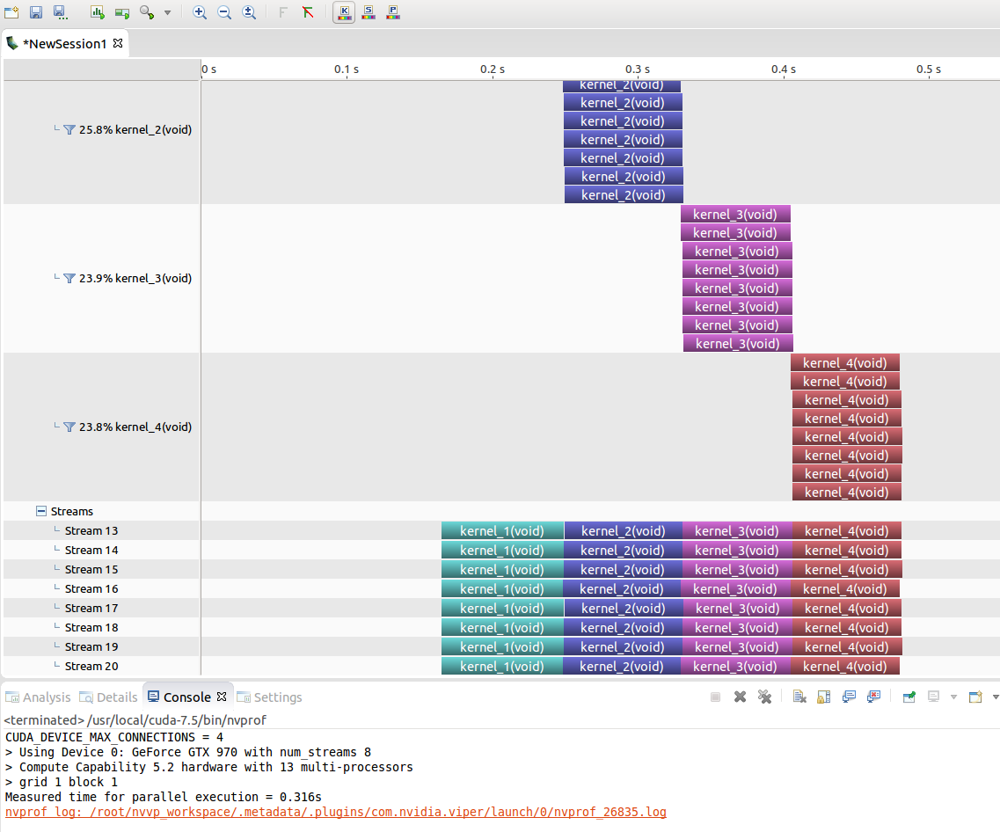
Dispatching the kernels in Breadth-First Order

Slide 52
Blocking Behavior of the Default Stream
//dispatch kernels in depth-first ordering
for(int i=0;i<n_stream; i++){
kernel_1<<<grid,block,0,stream[i]>>>( );
kernel_2<<<grid,block,0,stream[i]>>>( );
kernel_3<<<grid,block>>>( );//default stream
kernel_4<<<grid,block,0,stream[i]>>>( );
}

Slide 53
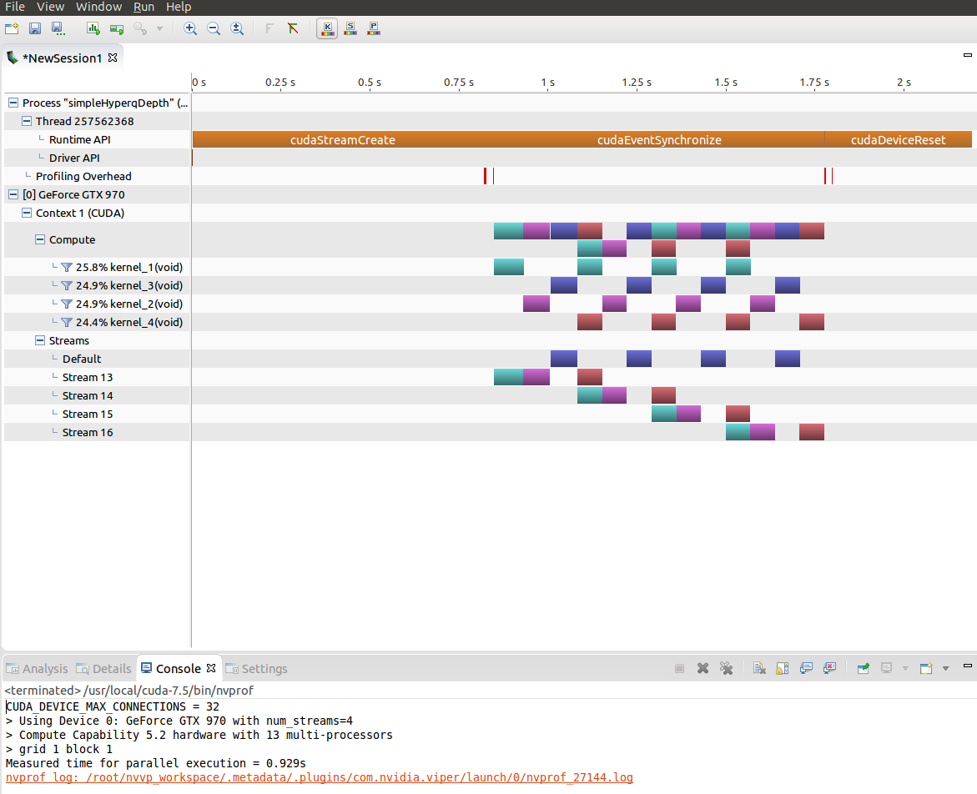
Blocking Behavior of the Default Stream

Slide 54
Any later operations on non-NULL streams will be blocked until the operations in the default stream complete.

Slide 55
Creating Inter-Stream Dependencies
*It can be useful to introduce inter-stream dependencies that block operations on one stream until operations in another stream have completed.
*Events can be used to add inter-stream dependencies.

Slide 56
Creating Inter-Stream Dependencies
cudaEvent_t *kernelEvent = (cudaEvent_t *)malloc(n_streams * sizeof(cudaEvent_t);
for(int i=0; i<n_streams;i++) {
cudaEventCreateWithFlags(&kernelEvent[i],cudaEventDisableTiming);
}
//dispatch job with depth first way
for(int i=0;i<n_streams;i++){
kernel_1<<<grid,block,0,streams[i]>>>();
kernel_2<<<grid,block,0,streams[i]>>>();
kernel_3<<<grid,block,0,streams[i]>>>();
kernel_4<<<grid,block,0,streams[i]>>>();
cudaEventRecord(kernelEvent[i],streams[i]);
cudaStreamWaitEvent(streams[n_streams-1],kernelEvent[i],0);
}

Slide 57
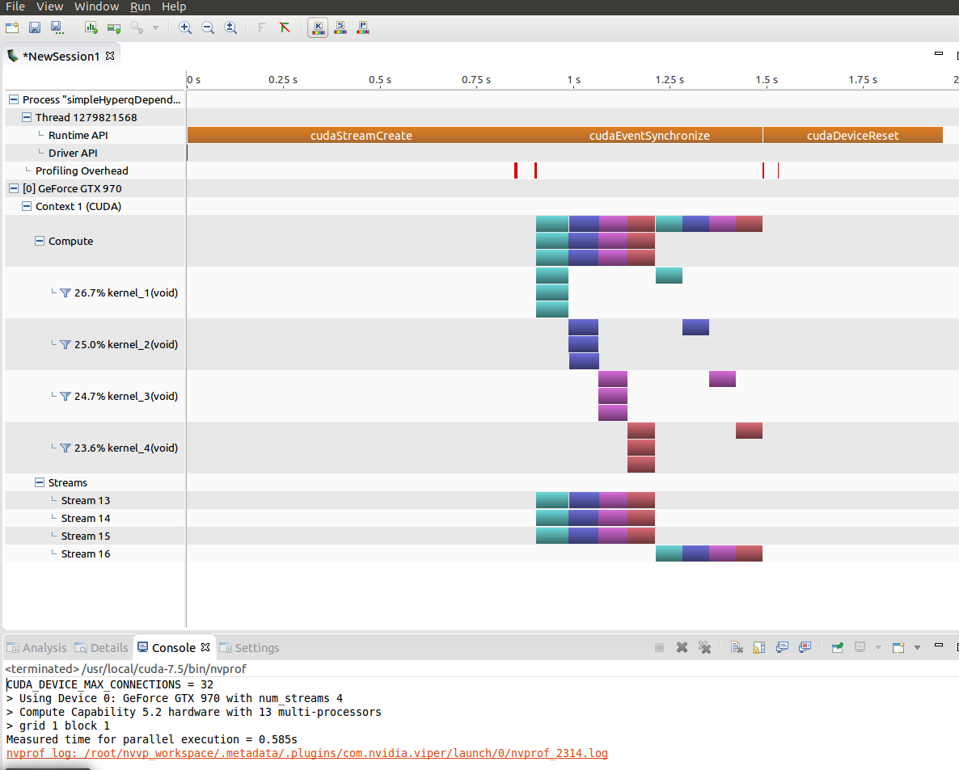
Creating Inter-Stream Dependencies

Slide 58
Overlapping Kernel Execution and Data Transfer
Fermi and Kepler GPUs have two copy engine queues: one for data transfer to the device, and one for data transfer from the device.
Overlapping kernel execution and data transfer:
If a kernel consumes data D, the data transfer for D must be placed before the kernel launch and in the same stream.
If a kernel does not consume any one of the data D, the kernel execution and data transfer can be placed in different streams.

Slide 59
Overlap Using Depth-First Scheduling
Vector Addition:
__global__ void sumArrays(float *A,float*B,float *C,const int N){
int idx=blockIdx.x*blockDim.x+threadIdx.x;
if(idx<N)
for(int i=0;i<n_repeat;i++){
C[idx]=A[idx]+B[idx];
}
}
To overlap data transfer with kernel execution, asynchronous copy functions have to be used.
Those asynchronous copy functions require pinned host memory:
cudaHostAlloc( );
Partition the work equally among NSTREAM streams:
int iElem = nElem/NSTREAM;

Slide 60
Overlap Using Depth-First Scheduling
for( int i=0; i<NSTREAM; ++i){
int ioffset=i*iElem;
cudaMemcpyAsync(&d_A[ioffset],&h_A[ioffset],iBytes,
cudaMemcpyHostToDevice,stream[i]);
cudaMemcpyAsync(&d_B[ioffset],&h_B[ioffset],iBytes,
cudaMemcpyHostToDevice,stream[i]);
sumArrays<<<grid,block,0,stream[i]>>>(&d_A[ioffset],
&d_B[ioffset],&d_C[ioffset],iElem);
cudaMemcpyAsync(&gpuRef[iofffset],&d_C[ioffset],iBytes,
cudaMemcpyDeviceToHost,stream[i]);
}

Slide 61
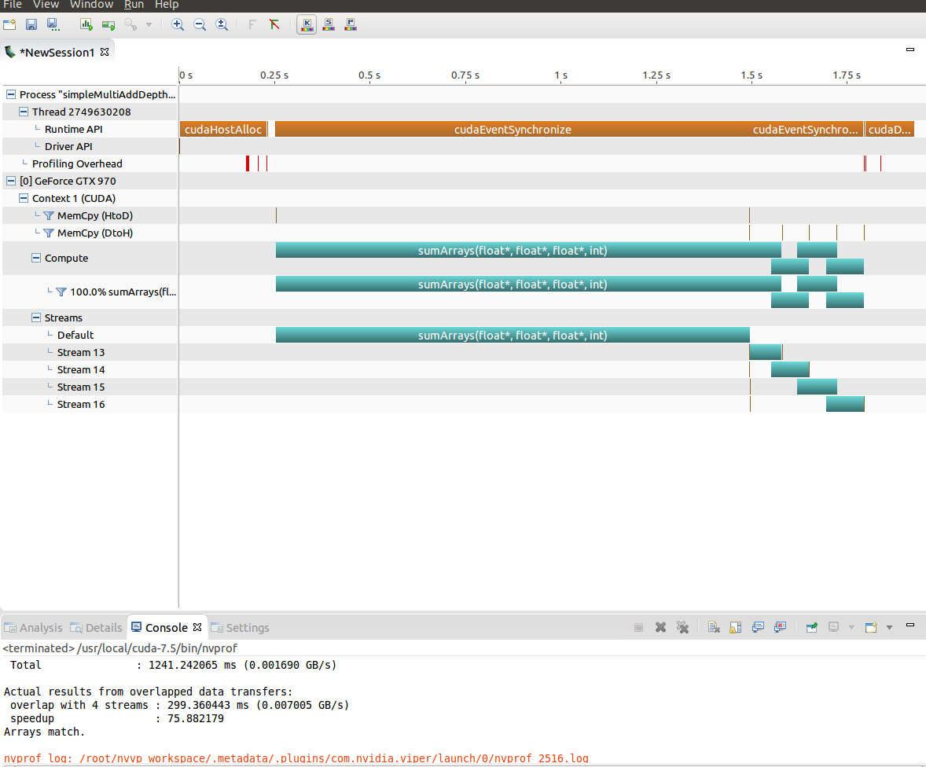
Overlapping Kernel Execution and Data Transfer Depth-First Scheduling

Slide 62
Breadth-First Approach
……..
// initiate all asynchronous transfers to the device
for (int i = 0; i < NSTREAM; ++i)
{
int ioffset = i * iElem;
CHECK(cudaMemcpyAsync(&d_A[ioffset], &h_A[ioffset], iBytes,
cudaMemcpyHostToDevice, stream[i]));
CHECK(cudaMemcpyAsync(&d_B[ioffset], &h_B[ioffset], iBytes,
cudaMemcpyHostToDevice, stream[i]));
}
// launch a kernel in each stream
for (int i = 0; i < NSTREAM; ++i)
{
int ioffset = i * iElem;
sumArrays<<<grid, block, 0, stream[i]>>>(&d_A[ioffset], &d_B[ioffset],
&d_C[ioffset], iElem);
}
// enqueue asynchronous transfers from the device
for (int i = 0; i < NSTREAM; ++i)
{
int ioffset = i * iElem;
CHECK(cudaMemcpyAsync(&gpuRef[ioffset], &d_C[ioffset], iBytes,
cudaMemcpyDeviceToHost, stream[i]));
}
// sequential operation
CHECK(cudaEventRecord(start, 0));
CHECK(cudaMemcpy(d_A, h_A, nBytes, cudaMemcpyHostToDevice));
CHECK(cudaMemcpy(d_B, h_B, nBytes, cudaMemcpyHostToDevice));
CHECK(cudaEventRecord(stop, 0));
CHECK(cudaEventSynchronize(stop));
float memcpy_h2d_time;
CHECK(cudaEventElapsedTime(&memcpy_h2d_time, start, stop));
CHECK(cudaEventRecord(start, 0));
sumArrays<<<grid, block>>>(d_A, d_B, d_C, nElem);
CHECK(cudaEventRecord(stop, 0));
CHECK(cudaEventSynchronize(stop));
float kernel_time;
CHECK(cudaEventElapsedTime(&kernel_time, start, stop));

Slide 63
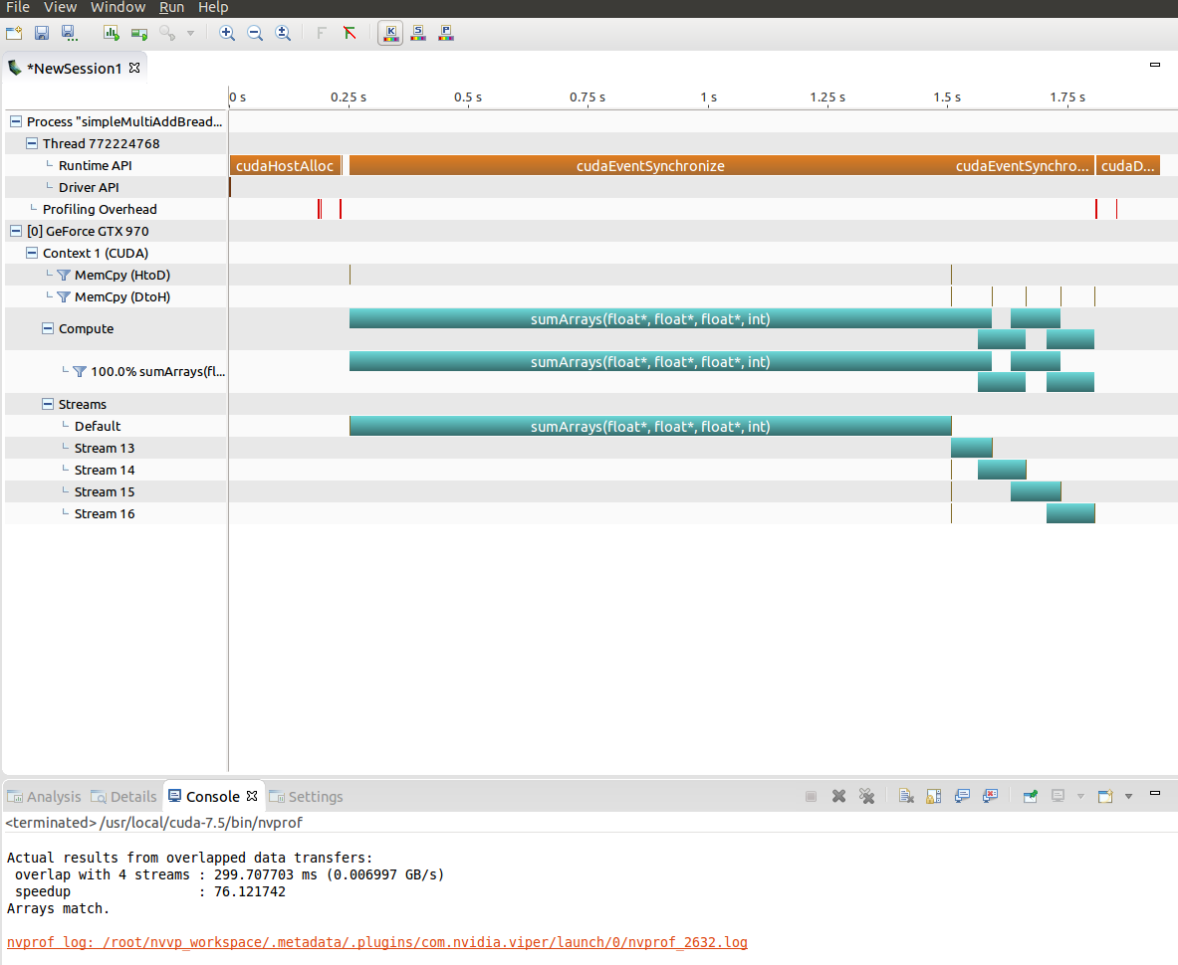
Breadth-First Scheduling

Slide 64
Overlapping GPU and CPU Execution
All kernel launches are asynchronous by default. Therefore, launching a kernel and immediately doing useful work in the host thread produces overlap of GPU and CPU execution.

Slide 65
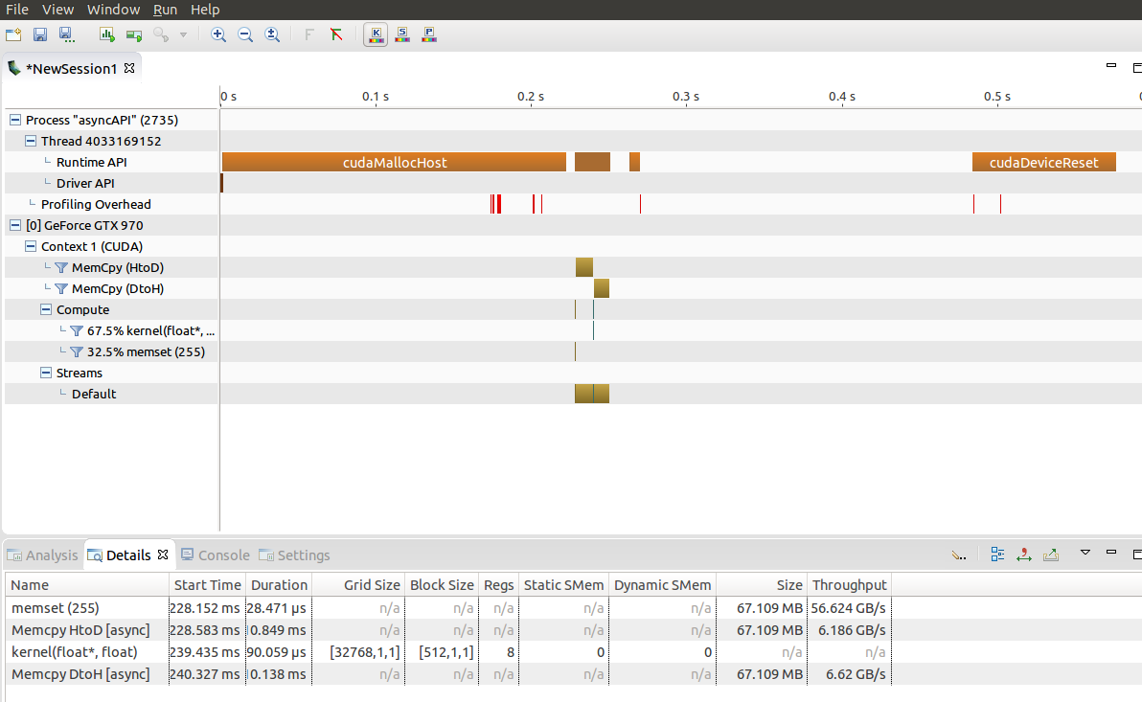
Overlapping GPU and CPU Execution

Slide 66
System Callbacks
When all of the operations in a stream preceding a stream callback have completed, a host-side function specified by the stream callback is called by the CUDA runtime.
Stream callback function: It is a host function provided by application and registered in a stream with the following:
cudaError_t cudaStreamAddCallback(cudaStream_t stream,cudaStreamCallback_t callbackm void *userData, unsigned int flags);

Slide 67
Stream Callback
for (int i=0; i<n_stream; i++){
stream_ids[i]=i;
kernel_1<<<grid,block,0,streams[i]>>>();
kernel_2<<<grid,block,0,streams[i]>>>();
kernel_3<<<grid,block,0,streams[i]>>>();
kernel_4<<<grid,block,0,streams[i]>>>();
cudaStreamAddCallback(streams[i],my_callback,
(void *)(stream_ids+i),0);
}

Slide 68
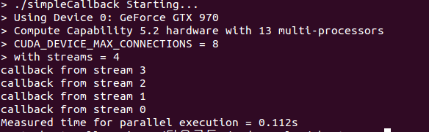
Stream Callbacks

